Slide 1
How You Can Prepare for a Flu Pandemic
A power point presentation
created by C. Mills & B. Thompson
Alabama State Department of Education
Prevention & Support Services
to be used
in conjunction with the
Individual and Family Handbook
published by
Alabama Department of Public Health

Slide 2

What is a flu pandemic?
It is a global outbreak of influenza (flu) – a respiratory disease.
A pandemic is the spread of a single disease.

Slide 3
The “flu” is caused by a virus
A flu virus has the potential to cause a pandemic.
  Flu viruses continually change.
  Continuous change could cause a new kind of flu.
  Nobody would be immune to the new virus.
Pandemic flu is not the same as seasonal flu or avian flu (p. 5).

Slide 4
Three Flu Pandemics in 20th Century
1918 – most severe – “Spanish flu” killed tens of millions of people around the world (approx. 500,000 died in the U.S.).
1957 – “Asian flu” killed about 2 million worldwide (approx. 70,000 died in the U.S.).
1968 – “Hong Kong flu” killed up to 1 million people around the world (approx. 34,000 died in the U.S.).

Slide 5
How likely is another flu pandemic?
Experts believe another pandemic is very
likely. A flu pandemic may:
start without warning anywhere;
spread quickly because of modern travel;
spread quickly because of densely populated areas;
come in multiple waves over several months.

Slide 6
What effects could a flu pandemic have?
Illness could be widespread
Services could be disrupted
  Medical care
  Police / fire departments
  Schools
  Commercial transportation
  Businesses (banks, grocery, etc.)
Community resources may be overburdened
Severe economic impact

Slide 7
Avian Flu
“Avian flu is known as the ‘bird flu.’ It is not the same as the pandemic flu; however, it may be the source of the next pandemic. In fact, all three 20th century pandemics were related to flu viruses that originally came from birds.”

Slide 8
One type of avian flu that could potentially lead to a pandemic: the H5N1 virus
Has caused outbreaks in domestic birds (chickens and ducks); started in Asia
Is spreading to birds outside of Asia; wild birds may carry the H5N1 virus as they migrate
Has been spreading to other animals, in some cases, such as pigs and tigers; there is a concern that the virus will be able to change and could easily infect humans

Slide 9
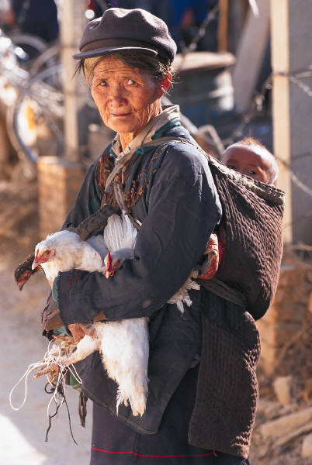
Some humans have been infected with the H5N1 bird flu. All were infected by having direct contact with domestic birds.
The virus does not yet spread easily from person to person. If it changes so that it could spread quickly between people, a pandemic could occur.

Slide 10
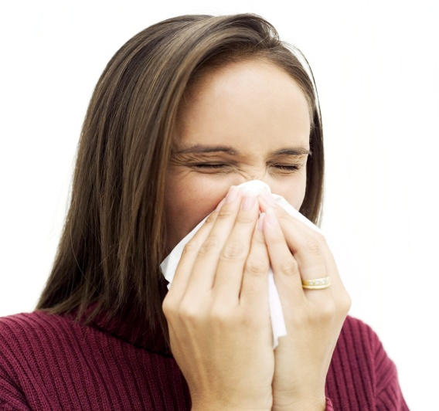
Some effects of avian flu in humans are:
Typical seasonal flu symptoms (fever, fatigue, cough, sore throat, body aches)
Eye infections
Life-threatening complications such as pneumonia or acute respiratory distress

Slide 11
Facts:
Disease experts are studying the H5N1 virus for changes, and they are also tracking other flu viruses.
The H5N1 virus may lead to the next pandemic –but it may not.
A pandemic cannot be predicted exactly.

Slide 12
Simple Steps to Take to Prepare for Pandemic Flu:
We all need to:
Understand how flu spreads
Learn how to help prevent infection
Practice healthy habits
Stay informed
Prepare an emergency kit
Cooperate with authorities in times of emergency

Slide 13
Pandemic Preparation is Underway. Governments around the world are getting ready. The U.S. federal authorities are:
Stockpiling vaccines and medications
Supporting research for new vaccines/medications
Establishing effective public health guidelines
Monitoring viruses around the world
Working to detect outbreaks & responding to them quickly
Helping state, local, tribal authorities develop pandemic flu response plans
Setting up systems for sharing emergency health information

Slide 14

States and communities are also preparing for pandemic flu.
Businesses are also encouraged to prepare by having an emergency communication plan, flexible work schedules, policies for sick leave, etc.
Individuals can play an active role in local preparedness by being ready in advance!

Slide 15
Vaccines and antiviral medications may or may not protect people from the flu and flu-related problems, so it’s important that you also practice good disease-control habits.
During a pandemic, vaccines and medications will be limited and given first to people who perform essential services (i.e.: health-care providers and public safety workers) and to people at high risk for complications (older people and children).

Slide 16
Facts about Vaccines and Antiviral Medications:
A vaccine helps the body become immune.
Vaccines help protect against existing viruses.
There is not yet a vaccine for pandemic flu.
Some potential vaccines are being developed.
Antiviral medications help treat the flu.
Antiviral medications are being developed to fight pandemic flu.
Stockpiling your own antiviral medications is not recommended.

Slide 17
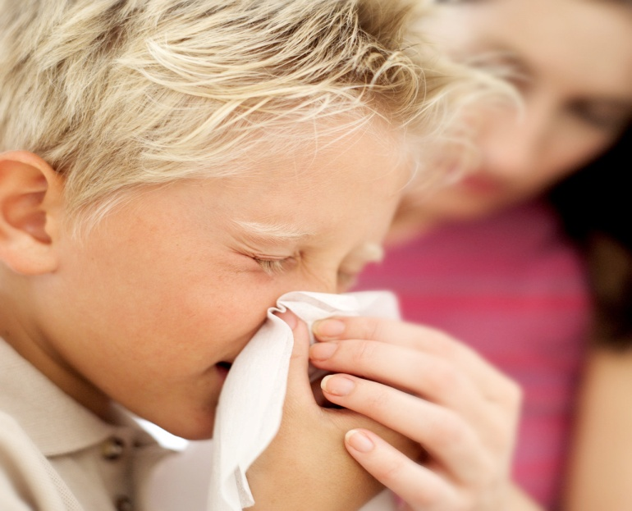
How the Flu Spreads
Germs spread mainly through coughs and sneezes
Infections can be passed by a sick person who is not experiencing any symptoms

Slide 18
How to Protect Yourself
Stay at least 3 feet away from a person who is coughing or sneezing.
If you are sick, stay home from work, school, or outings.
Practice cough and sneeze etiquette.
  When coughing and/or sneezing:
  Stay at least 3 feet away from other people
  Cover your mouth and nose with tissue, throw tissue away
  Use your upper sleeve if you do not have a tissue (not your hand)
  Always wash your hands right away afterward

Slide 19
Personal hygiene and keeping things clean are great ways to help yourself and others stay healthy.
Washing hands is
very important
Disinfect shared objects
and common areas
Don’t share personal items
Teach children healthy
hygiene habits

Slide 20
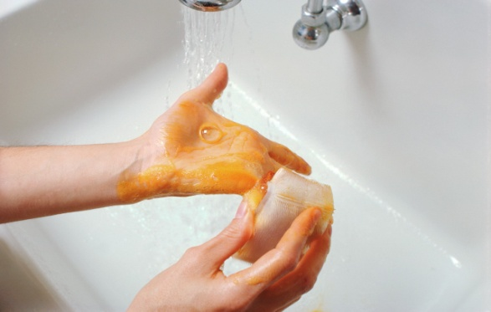
Simple Hand Washing Steps
Wet hands with warm water
Lather up both hands with soap
Scrub hands together for at least 20 seconds (for children, choose a song that last 20 seconds)
Rinse hands thoroughly
Dry hands completely
Note: Alcohol-based hand sanitizers can substitute for soap and water.

Slide 21
Practice Food Safety
Handle meat (including poultry) with care:
Wash hands before and after touching meat
Store and prepare raw meat separately from other foods
Use a separate cutting board for preparing raw meat
After use, thoroughly wash cutting board and utensils with soap and hot water
Don’t let raw meat or its juices touch anything that will not be cooked

Slide 22
Poultry and eggs are safe to eat if cooked properly.
Cook poultry to at least 165° F.
Cook eggs until whites and yolks are firm.
For more information, call the
USDA Meat and Poultry Hotline:
1-888-MPHotline (1-888-674-6854)
1-800-256-7072(TTY)

Slide 23
Because it is possible to catch flu germs from an infected bird, pig or other animal, the U.S. poultry producers are working to keep domestic birds healthy by:
Keeping domestic poultry away from wild birds
Cleaning and disinfecting equipment and vehicles
Having employees wear clean clothing and follow strict disinfecting practices

Slide 24
Basic Precautions to Help Prevent Possible Infection:
Report sick birds
Be careful with wildlife
Talk to children; let them know not to touch sick or dead animals/birds

Slide 25
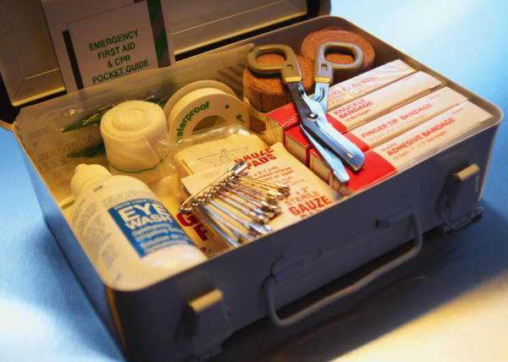
Create an Emergency Kit
Gather supplies for at least 2 weeks and rotate your stock once or twice a year.
Items to collect:
Drinking water
Personal supplies
Nonperishable food
Household goods
Medical essentials

Slide 26
Get a Yearly Flu Shot!
Helps protect against the flu for that season
Get the shot early in the season – in October or November
Recommended for people at high risk
  Adults 50 and older
  Children 6 – 23 months old
  People with long-term conditions (diabetes)
  Women who will be pregnant during flu season
  People with weakened immune systems (HIV)
  People living in nursing homes or long-term care facilities
Side effects of a shot are usually mild
A nasal spray vaccine may be available

Slide 27
Refer to the Flu Pandemic checklist on page 18 in the handbook for specific information on how to prepare and what to store for a possible pandemic.

Slide 28


Stay Informed with Up-to-date Information
Keep track of what is going on in your area and around the nation
Media will work with authorities on current flu-related events
Most reliable sources of information are public health authorities and the government Web sites:
www.adph.org and www.pandemicflu.gov
Local hotlines may be set up

Slide 29
Cooperation is Key!
Authorities may make “common-good” decisions for all to follow in order to help reduce the public’s exposure. Common good decisions may include:
Asking everyone to follow certain hygiene steps
Limiting public gatherings and events
Requesting everyone to stay home for a certain period
Limiting travel
Closing businesses

Slide 30
Know Your Community’s Strategies and Resources.
Find out about plans in your school/community area for:
Prevention of infection
Containment of local outbreaks
Sharing emergency health information with all community members
Giving out food and water to those who need it
Distributing medications or vaccines

Slide 31
You Can Help!
Consider volunteering with a local organization by :
Planning a telephone tree to share information among people
Creating a local map of key services
Organizing assistance for people with special needs
Gathering supplies for neighbors or other community members

Slide 32
Local organizations may include:
Your local county health department
A community health group
A local or national aid organization
An emergency preparedness task force
A faith-based organization
Other

Slide 33
Traveling Precautions
Before you travel:
Check health advisories. For example, visit www.cdc.gov/travel
Get up-to-date vaccines
Check health insurance to see if it covers you abroad; buy additional insurance if needed
Pack a basic first-aid kit, including a thermometer
Take alcohol-based hand sanitizer

Slide 34
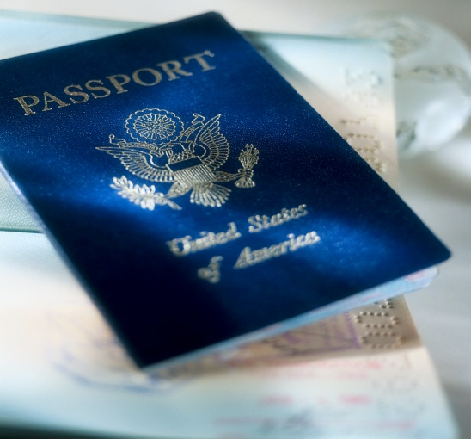
While traveling abroad:
Avoid contact with domestic birds
Do not eat partially cooked poultry or eggs
Clean your hands often
If you need medical help, check with the U.S. consulate in the country you are visiting

Slide 35
After you return home:
Monitor your health for 10 days
Call your health-care provider if you feel sick and inform him/her of where you have been

Slide 36
It is good to have backup plans ready in case of a pandemic. Write down information about how your child’s school, your workplace, etc., plan to respond to a pandemic. A Backup Plan Worksheet is located on page 23 of your pamphlet. You may want to reproduce this page and make your own backup plans for you and your family.

Slide 37
Stay Healthy!
Taking care of yourself can help you handle the physical and emotional impact of the flu.
Eat right.
Get enough physical activity.
Manage stress.

Slide 38
Coping with the Flu
Seasonal flu symptoms may include:
Cough
Fever
Fatigue
Headache
Sore throat
Stuffy or runny nose
Muscle aches

Slide 39
Pandemic flu symptoms may be more severe than seasonal flu symptoms.
Officials will share common signs and symptoms with the public if a pandemic strikes.

Slide 40
Treatment for Seasonal Flu May Include:
Staying home to avoid spreading it to others
Taking antiviral medication
Drinking lots of fluids
Getting plenty of rest
Taking fever reducer

Slide 41
Pandemic flu treatment may be similar to treatment for seasonal flu. Officials and health-care providers will give specific recommendations once a pandemic has begun.
STAY AWAY FROM OTHERS WHEN YOU ARE SICK!

Slide 42
Home Care for Others with the FLU
Keep the person away from others
Follow health-care provider instructions
Give medications if prescribed and available
Throw away used tissues immediately
Wash or sanitize your hands often
Avoid holding soiled laundry too closely

Slide 43
Talk To Your Loved Ones About the Flu and How You Can Be Prepared
Help children feel safe
Monitor the news
Talk about good hygiene
Communicate with loved ones outside of your household
For more information, consult your federal, state, and local resources. An extensive list is provided on page 27 of your pamphlet.

Slide 44
Works Cited
2006 Channing Bete Company, Inc.
All rights reserved.

